Slide 1
Switching & LAN Design

Slide 2
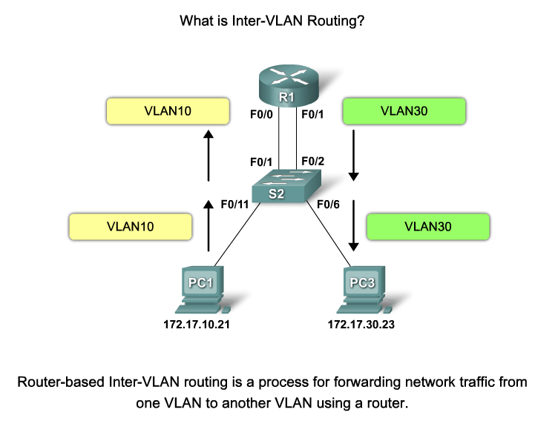
Inter VLAN routing

Slide 3
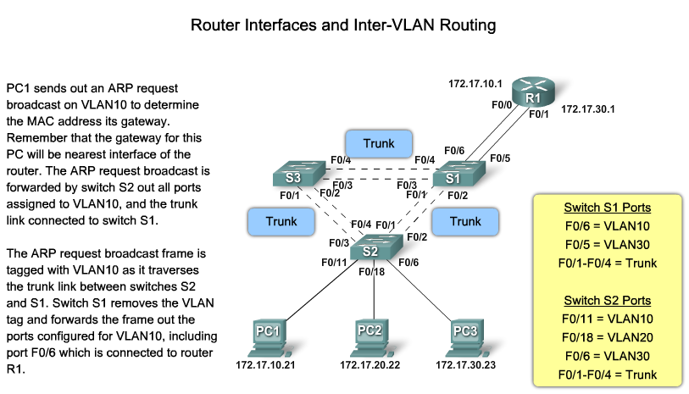
Traditional Inter VLAN routing

Slide 4
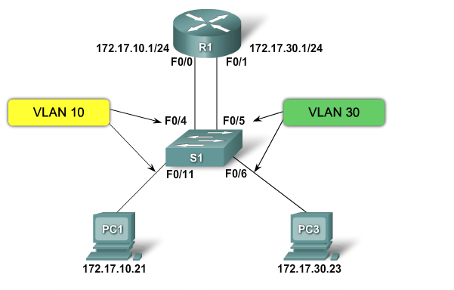
How to configure traditional inter-VLAN routing ?

Slide 5
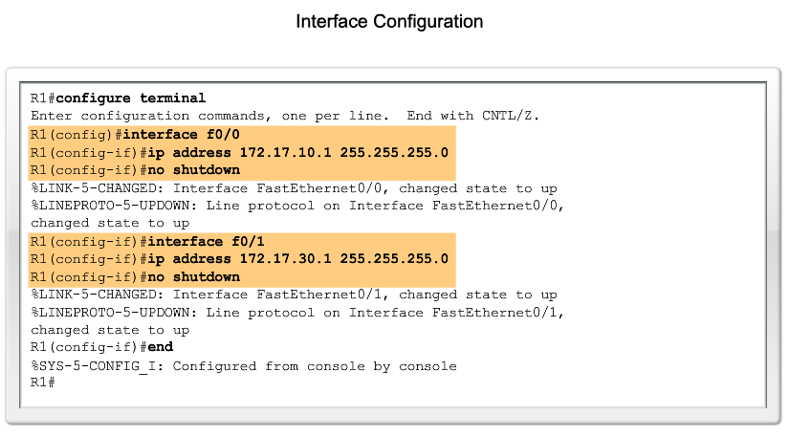
How to configure traditional inter-VLAN routing ?

Slide 6
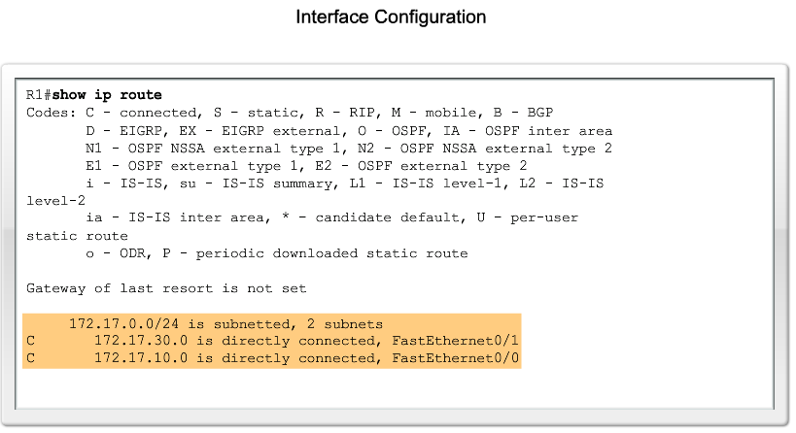
How to configure traditional inter-VLAN routing ?

Slide 7
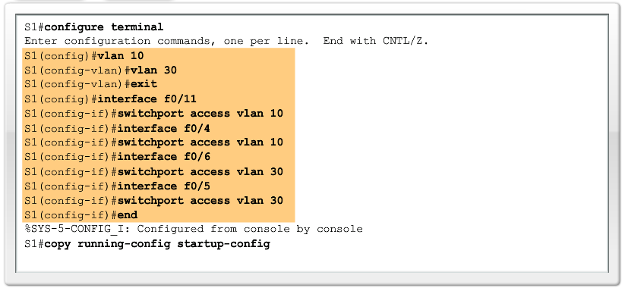
How to configure traditional inter-VLAN routing ?

Slide 8
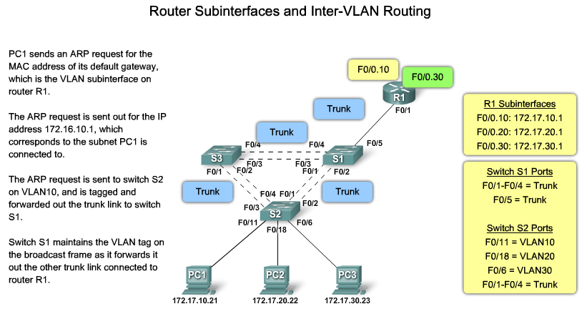
Modern +.
Modern inter-vlan routing (router on a stick)

Slide 9
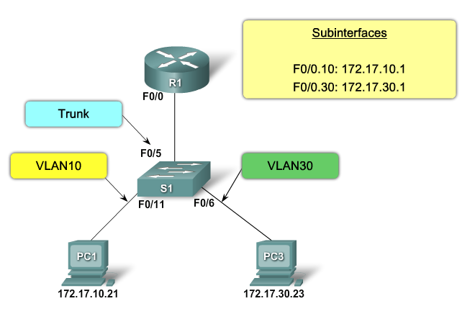
How to configure modern inter-VLAN routing ?

Slide 10
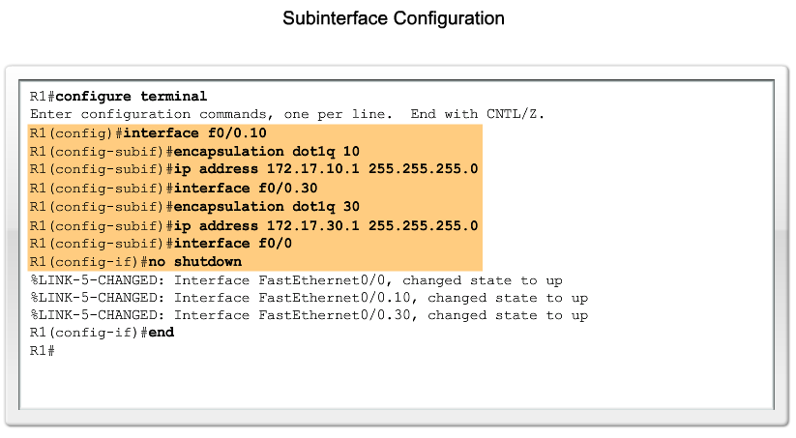
How to configure modern inter-VLAN routing ?

Slide 11
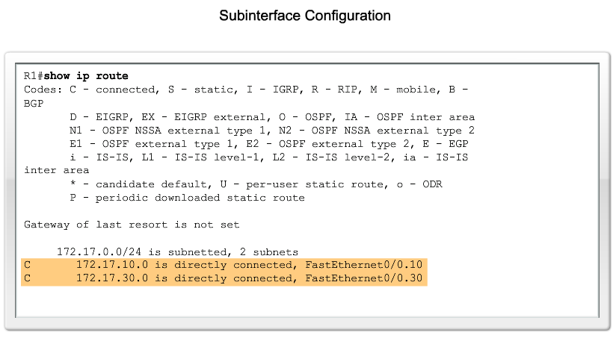
How to configure modern inter-VLAN routing ?

Slide 12
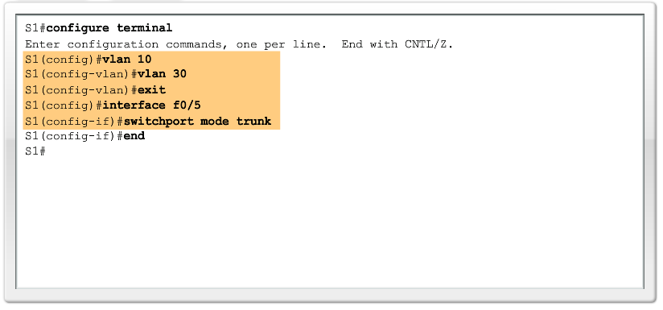
How to configure modern inter-VLAN routing ?

Slide 13
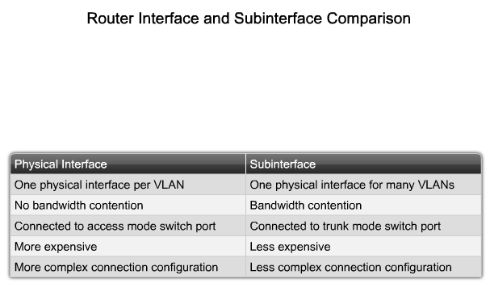
Physical interface vs. subinterface

Slide 14


Slide 15
The most modern InterVLAN Routing Method
Switched Virtual Interface

Slide 16
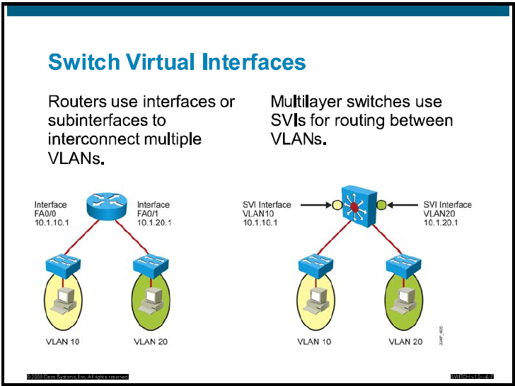

Slide 17
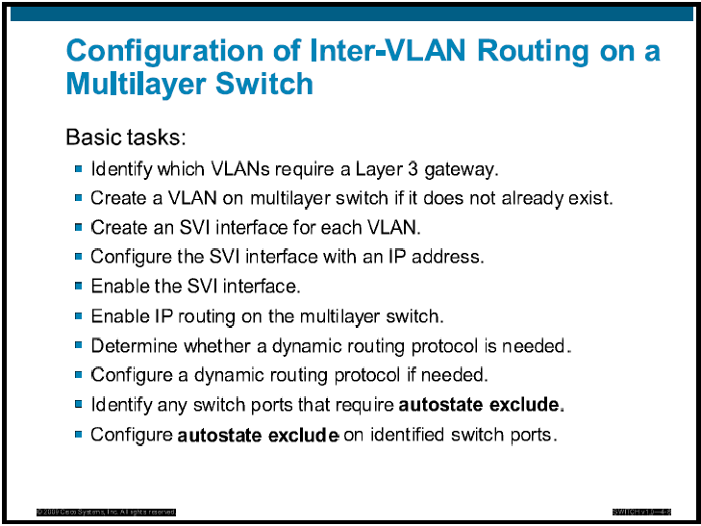

Slide 18
